Slide 1
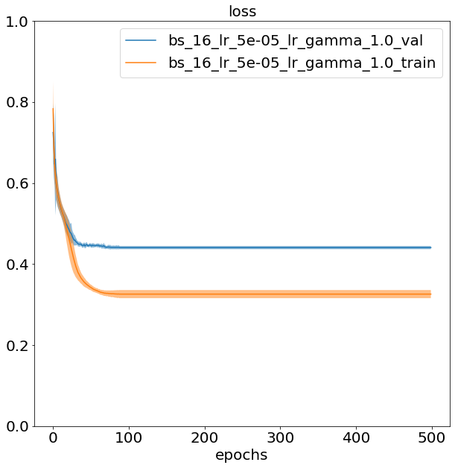
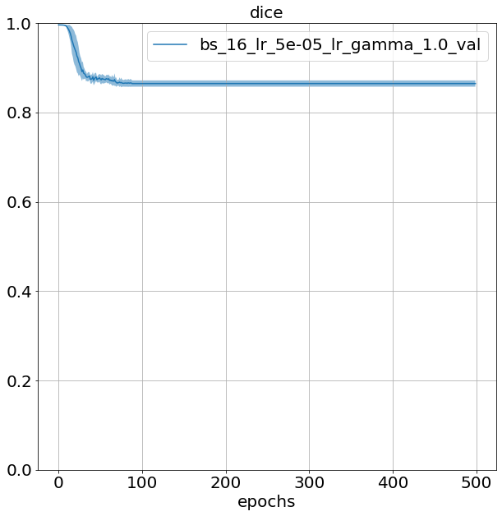
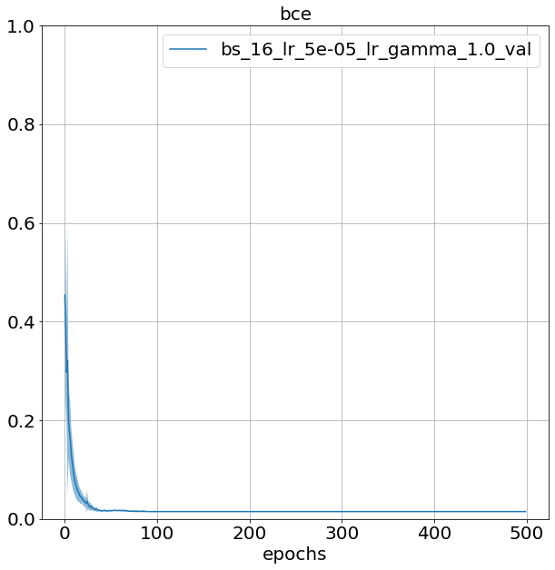
Segmentation apical lesions 27-11-2020
IoU = 1 - dice loss
Reshaped to 224x224 px
Batch size: 16
Learning rate: 5e-5
No img augmentation
Model: U-net
Results on test data:
loss | Dice loss | bce
0.362 ± 0.040 | 0.712 ± 0.077 | 0.013 ± 0.002

Slide 2
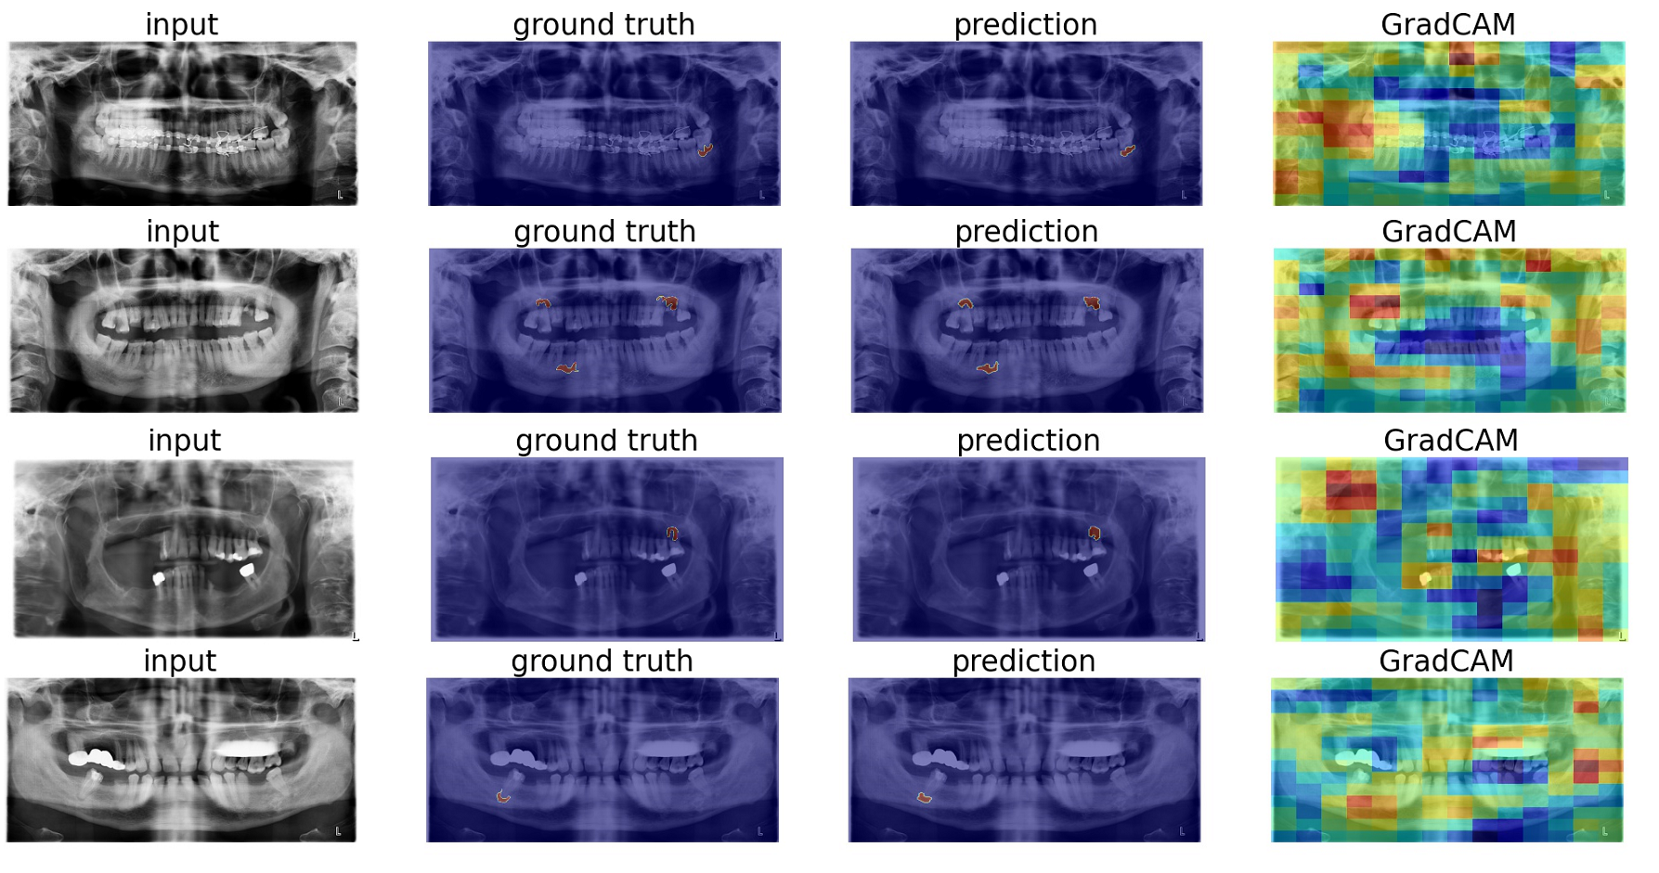

Slide 3
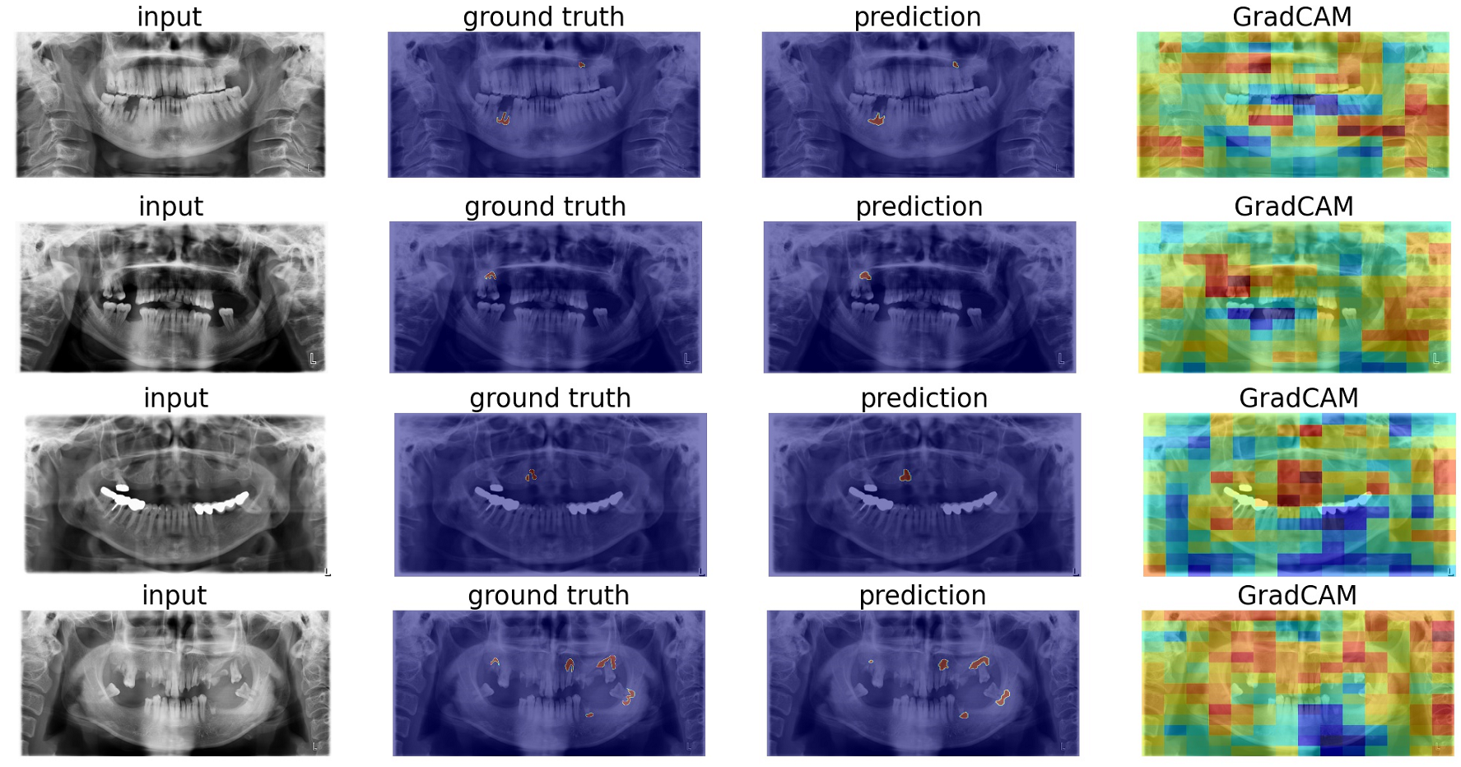

Slide 4
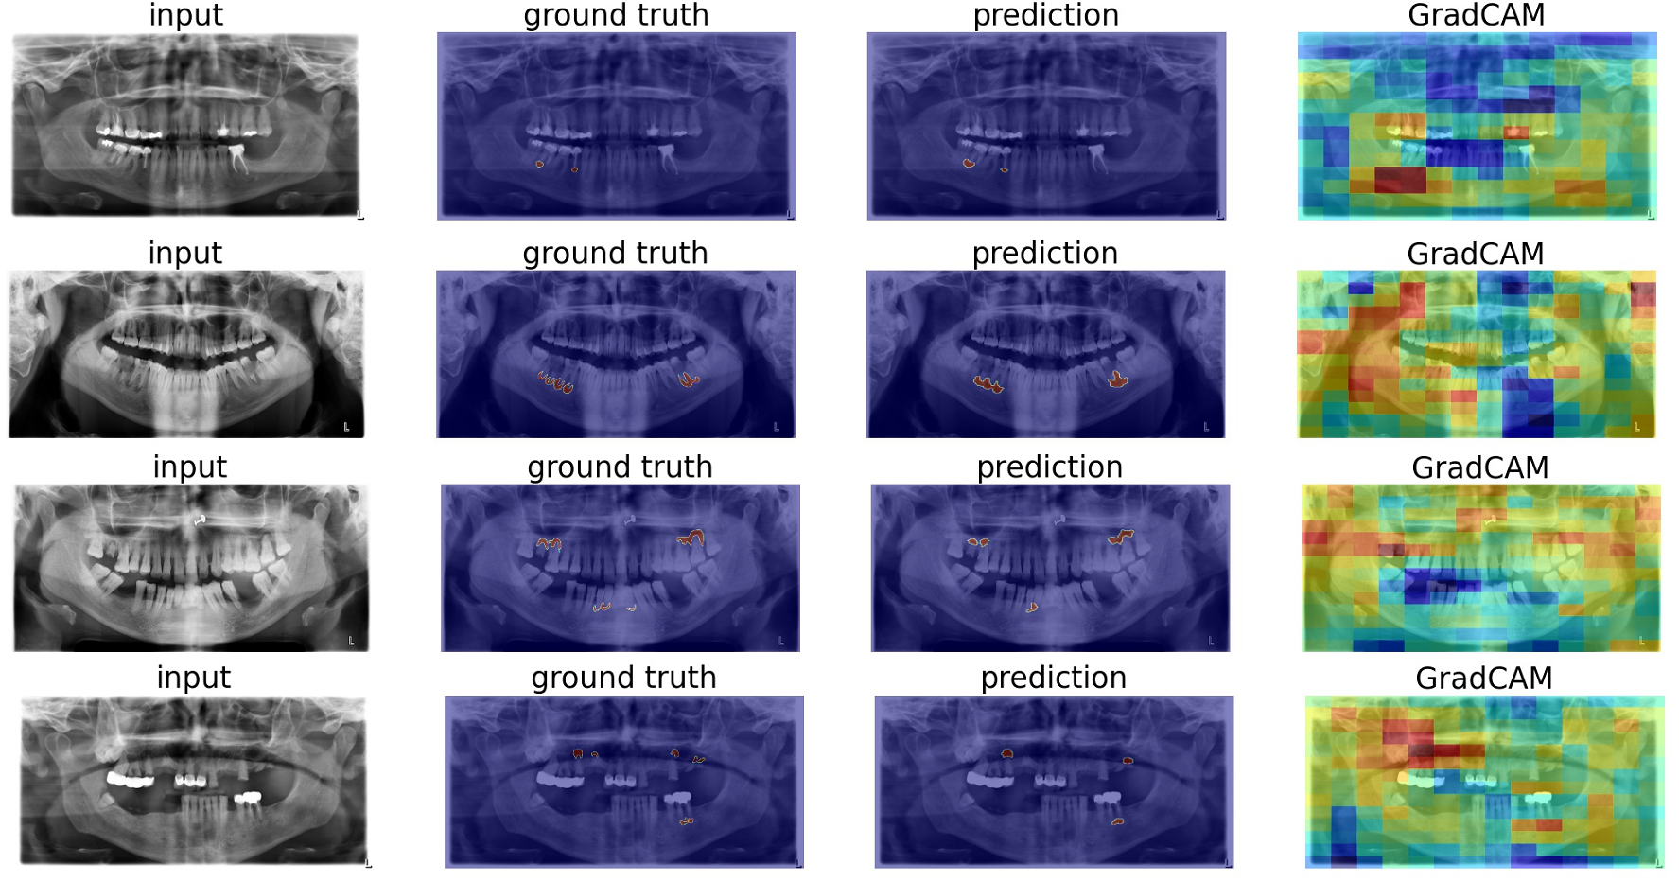

Slide 5
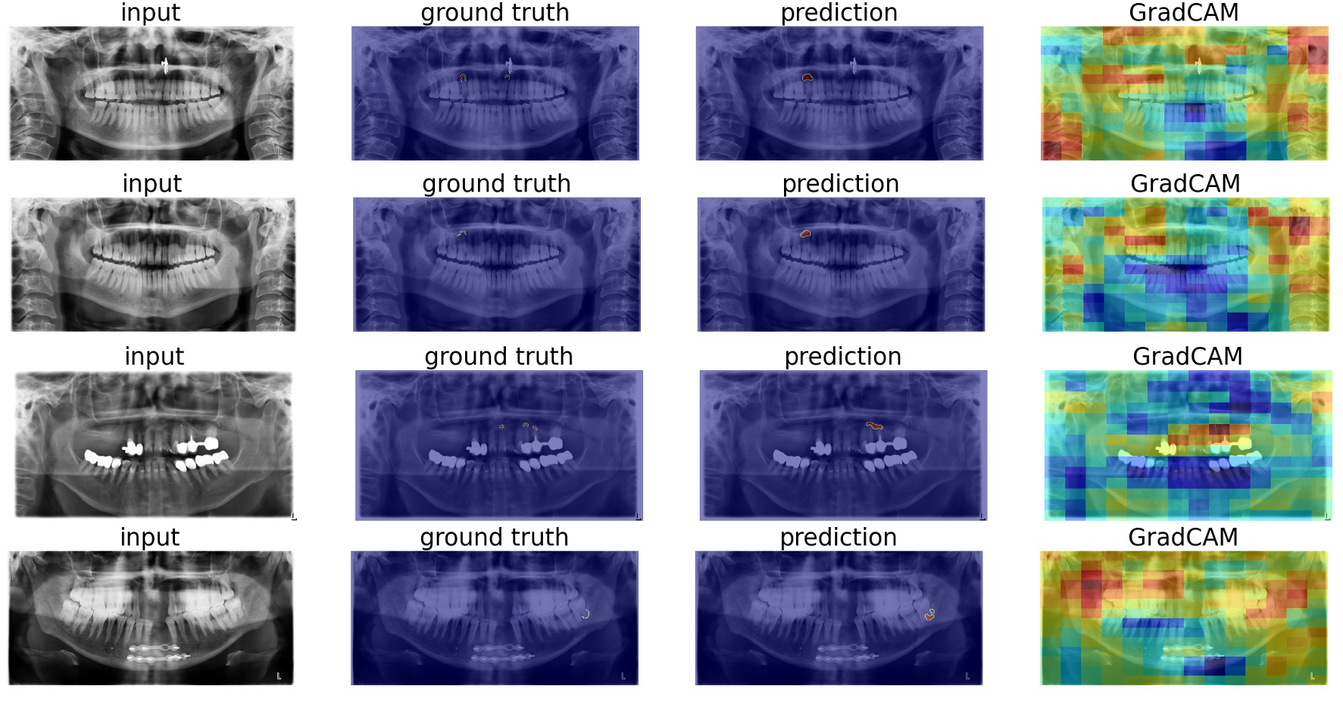

Slide 6
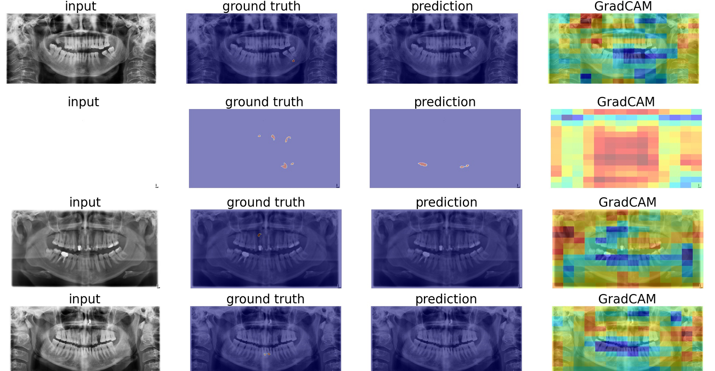

Slide 7
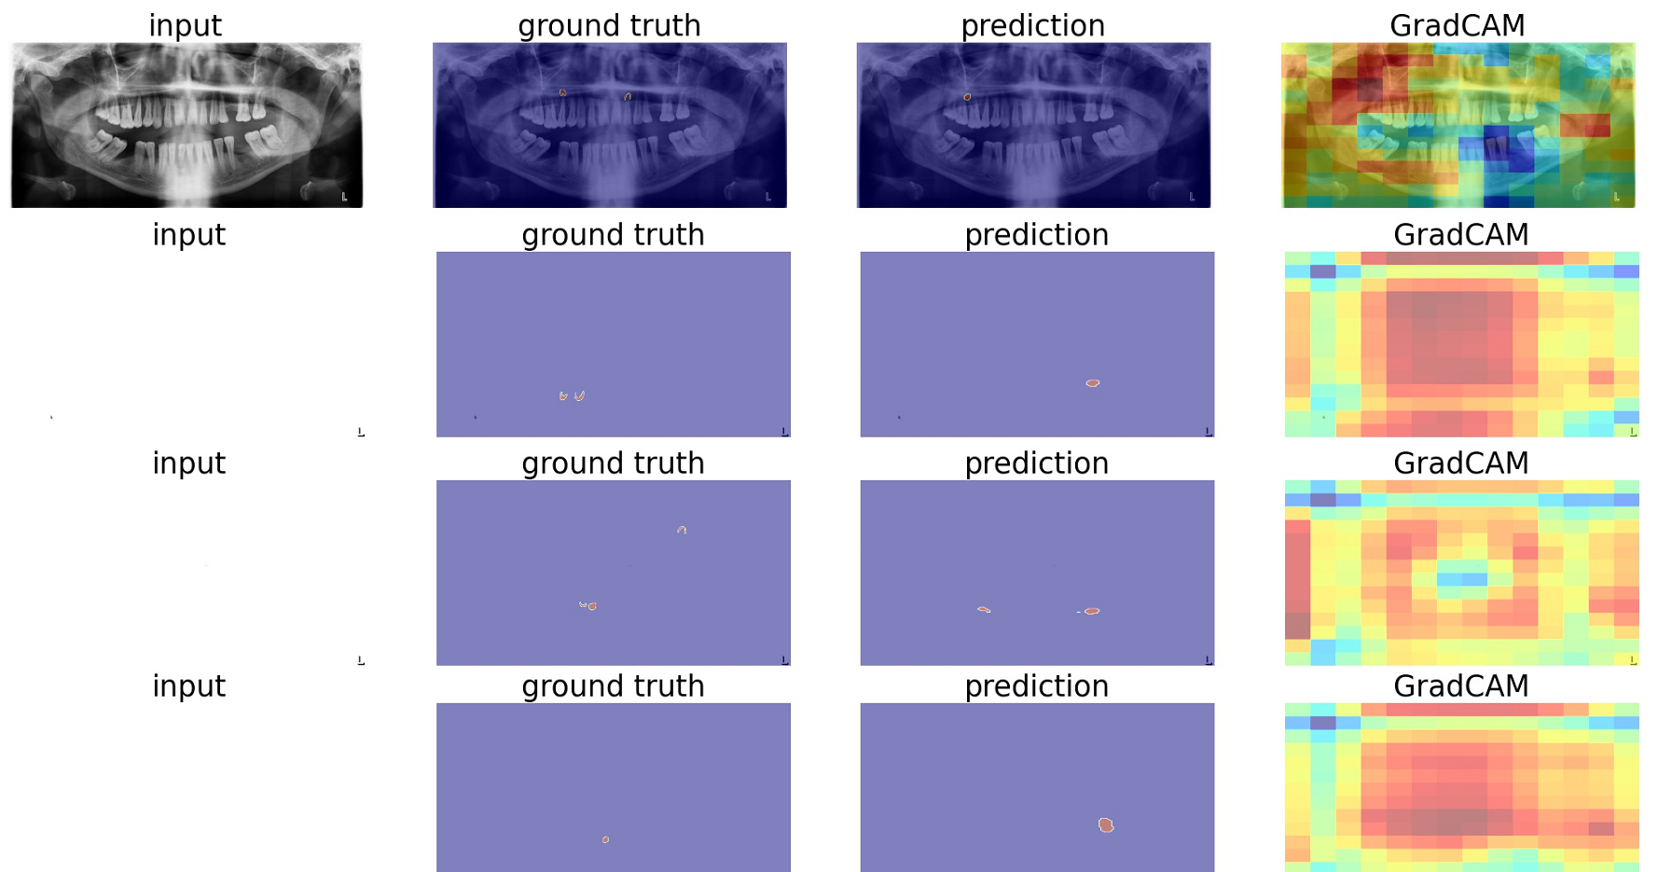

Slide 8
